Slide 1
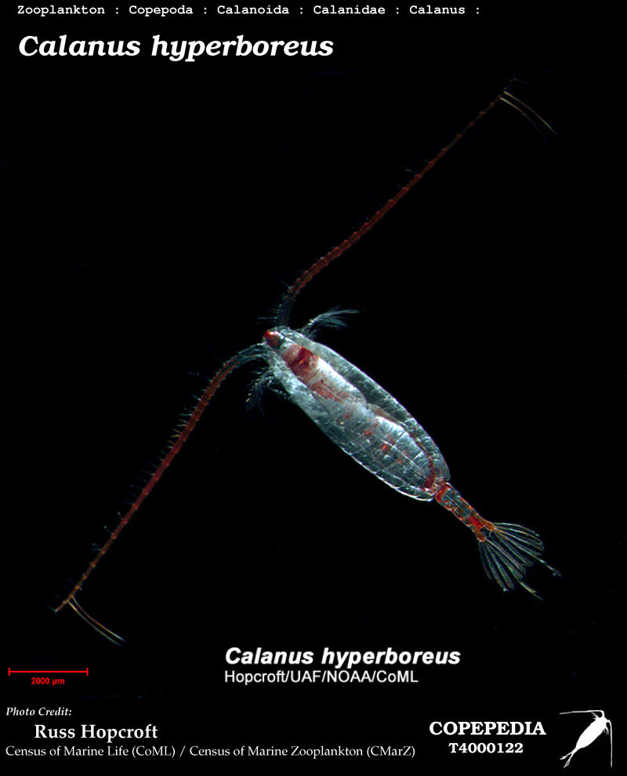

GOT STRUCTURE?
Population Genetic Structure and Demographic History of Calanus hyperboreus
Sebastian L. Berg
Photo Credit: Russ Hopcroft

Slide 2
Introduction
Critical in marine ecosystems:
Nutrient cycling
Linking primary producers and secondary consumers
Genetic Studies:
Responses to environmental change
Contrasting Expectations:
High gene flow expected
Significant genetic structure found
Photo Credit: Russ Hopcroft
Notes:
Linking primary producers and secondary consumers

Slide 3
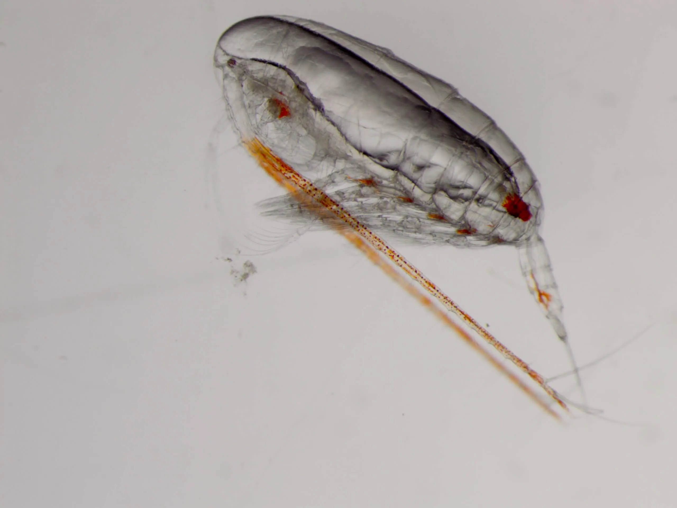
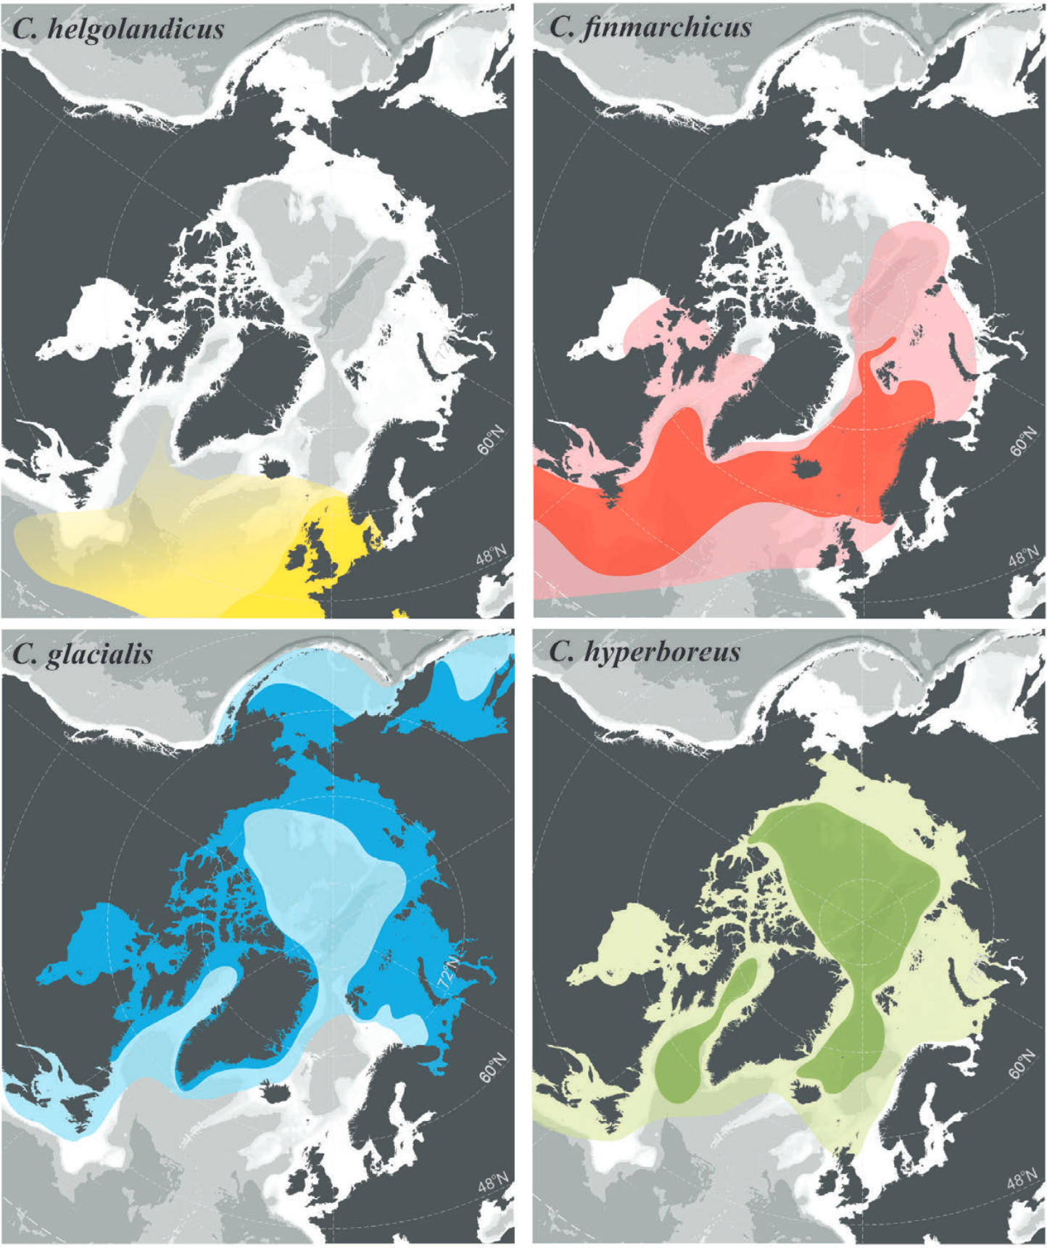
Calanus and its Importance
Lipid Sac
(Machine Learning and Plankton: Copepod Prosome and Lipid Sac Segmentation, 2023)
Dominance
Arctic and Atlantic oceans
Key Role
Lipid accumulation
Life-Cycle
Nutrients
temperature
Photoperiod
Distributions of four Calanus species (Choquet, 2017)

Slide 4
Population Structure and C. hyperboreus
Lipid Sac
Variability:
Population structure varies across Calanus species
Focus: C. hyperboreus
A keystone species in Arctic food webs
Unique adaptations
Prolonged life cycle
Overwintering diapause
Capital breeding
(Machine Learning and Plankton: Copepod Prosome and Lipid Sac Segmentation, 2023)

Slide 5




Research Questions
Efficacy of TCS probes in a non-model organism
Population genetic structure of C. hyperboreus in the North Atlantic and Arctic
Demographic history

Slide 6
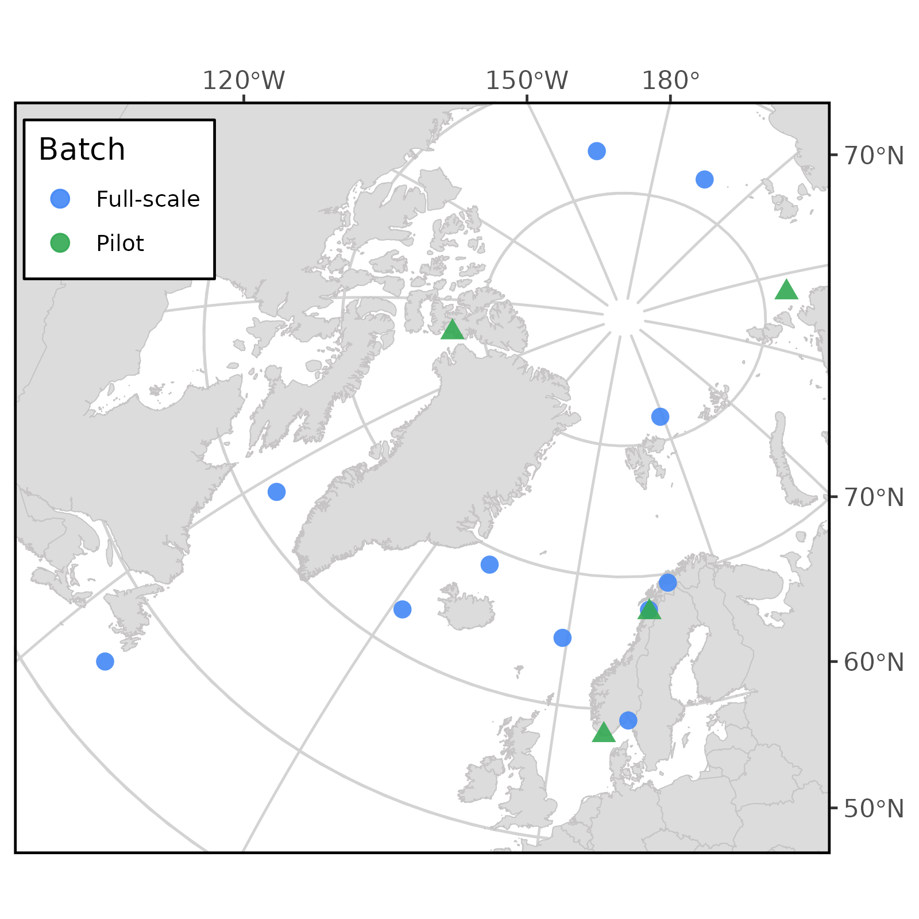
Methods: Sampling Locations
Sequencing data from previous work
Done in two batches:
Pilot
Full-scale
Approximately four samples per site

Slide 7
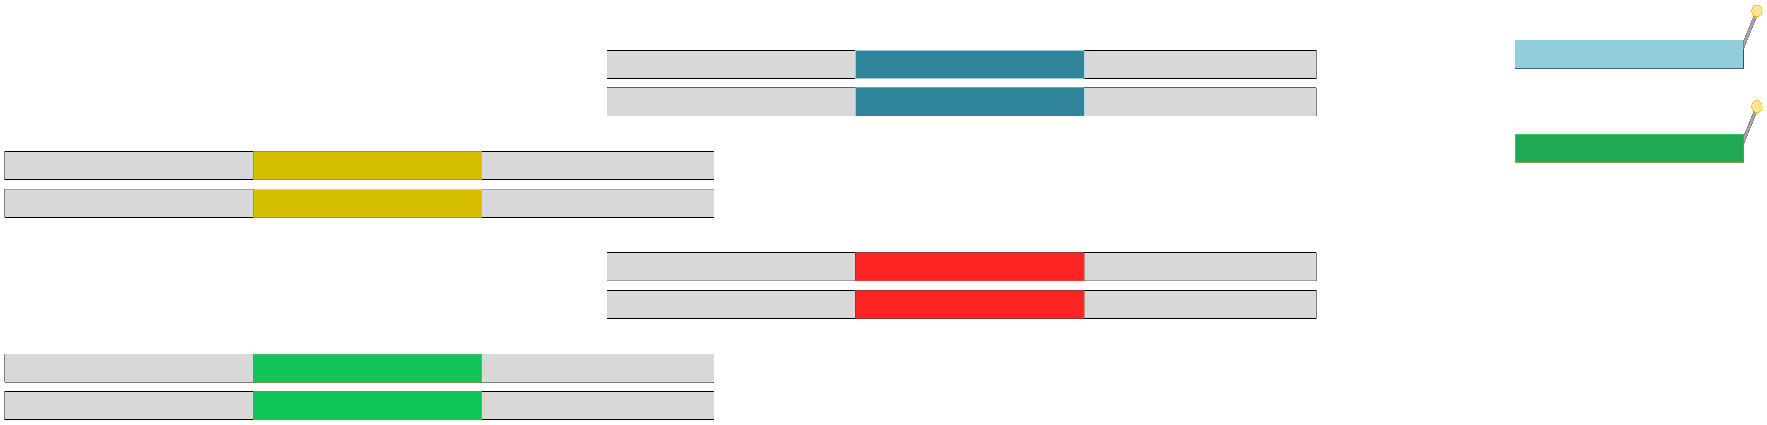
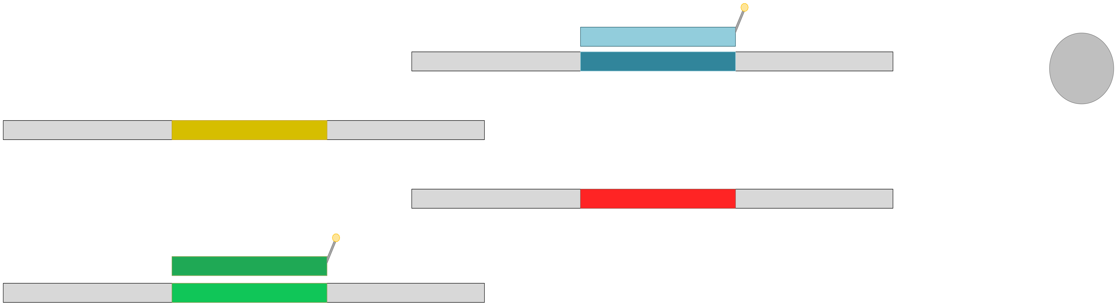
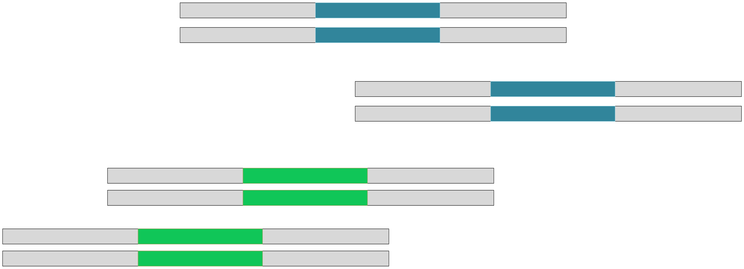
Methods: Reduced Representation and Target Capture Sequencing
Library preparation
Probes
Genomic DNA
Hybridization
Large and repetitive genome
Difficulty in reference genome assembly
High error rates in NGS data
Whole genome sequencing (WGS)
Prohibitively expensive
Computationally intensive
Target capture sequencing (TCS)
Magnetic beads
Purification
Notes:
Difficulty in assembly of ref genome

Slide 8
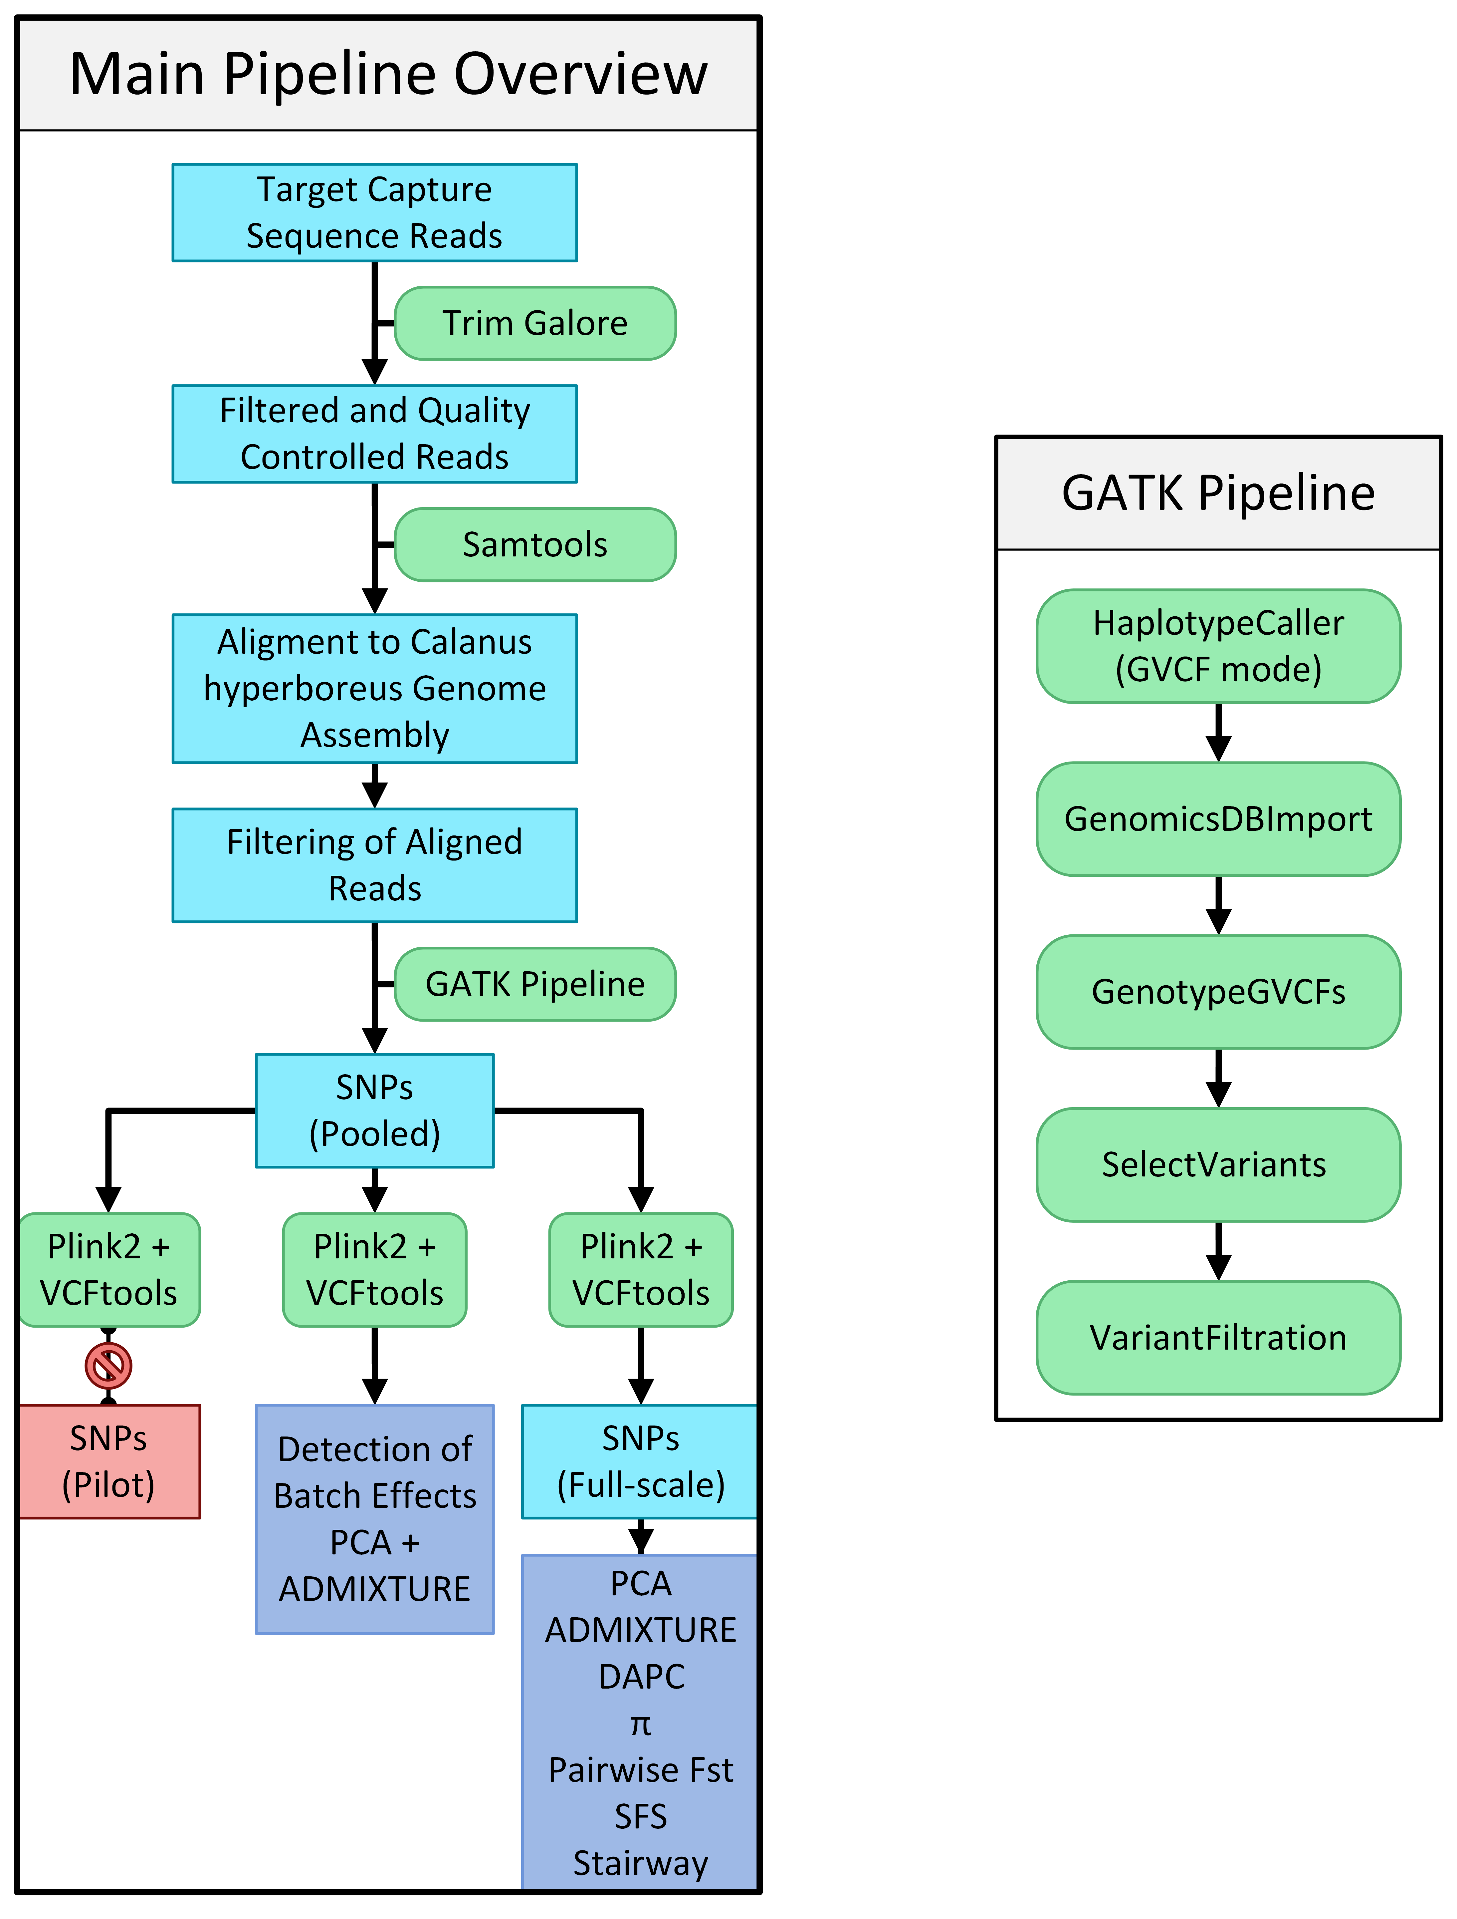
Methods: Pipeline
Extracted DNA
Target capture sequencing
Bioinformatics approach
Number of obtained SNPs
Called variants: | 4,938,241
SNPs: (before filters) | 4,901,092
SNPs: (Passed MD filter) | 2,382
SNPs: (Passed HW+LD filters) | 389

Slide 9
Methods: Statistical Analyses
Population Structure
Population Demography
Principal Component Analysis (PCA)
Discriminant Analysis of Principal Components (DAPC)
Admixture Analysis
Nucleotide Diversity (π)
Pairwise FST Analysis.
Tajima’s D
Site Frequency Spectrum (SFS)
Stairway Plots
Notes:
Population History:
Tajima’s D
Detect deviations from neutral evolution
Site frequency spectrum (SFS)
Provides a summary of the allele frequencies in the population, can reveal signatures of past demographic events
Stairway plots
Illustrate the change in effective population size over time

Slide 10
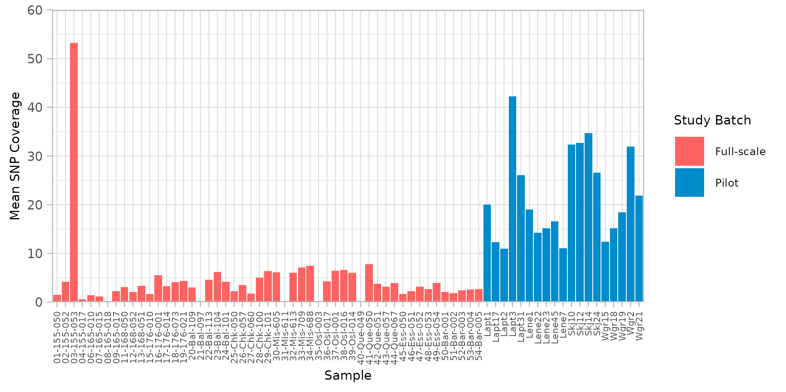
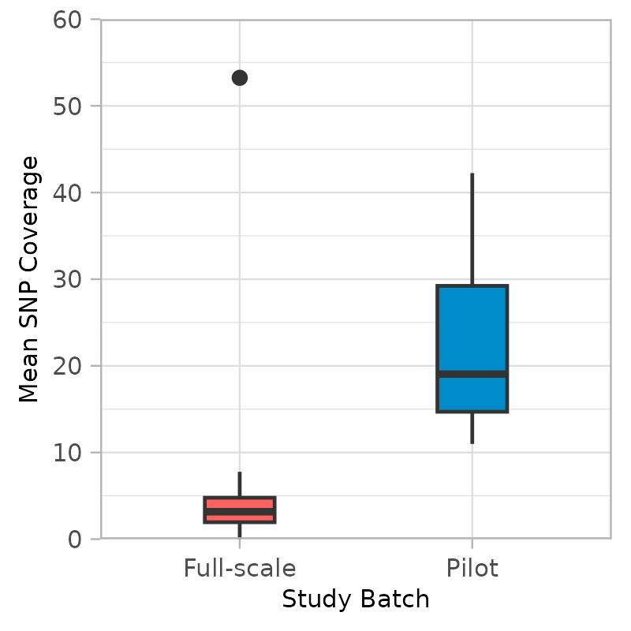
Results: Batch Effects
Mean SNP coverage differs per batch
Sample SNP coverage
Batch SNP coverage

Slide 11
Results: Batch Effects
Metrics affected by batch effects
Deduplication of reads removed
Mean: 71.143%
Pilot: 18.62%
Full-scale: 89.621%
Statistical tests comparing the pilot and full-scale batches
 | Levene |  | Shapiro-Wilks |  | Man-Whitney U
 | F-statistic | Pr(>F) | W | p-value | W | p-value
Raw reads (pre-trim) | 4.3862 | 0.03985* | 0.96148 | 0.02677* | 589 | 0.3425
Total pairs (post-trim) | 4.0644 | 0.04764* | 0.9593 | 0.02017* | 578 | 0.4174
Post-deduplication | 36.788 | 6.01E-08* | 0.72055 | 2.10E-01* | 6 | 1.92E-10*
Retained pairs (%) | 0.3629 | 0.5488 | 0.6427 | 5.94E-12* | 0 | 1.17E-10*

Slide 12
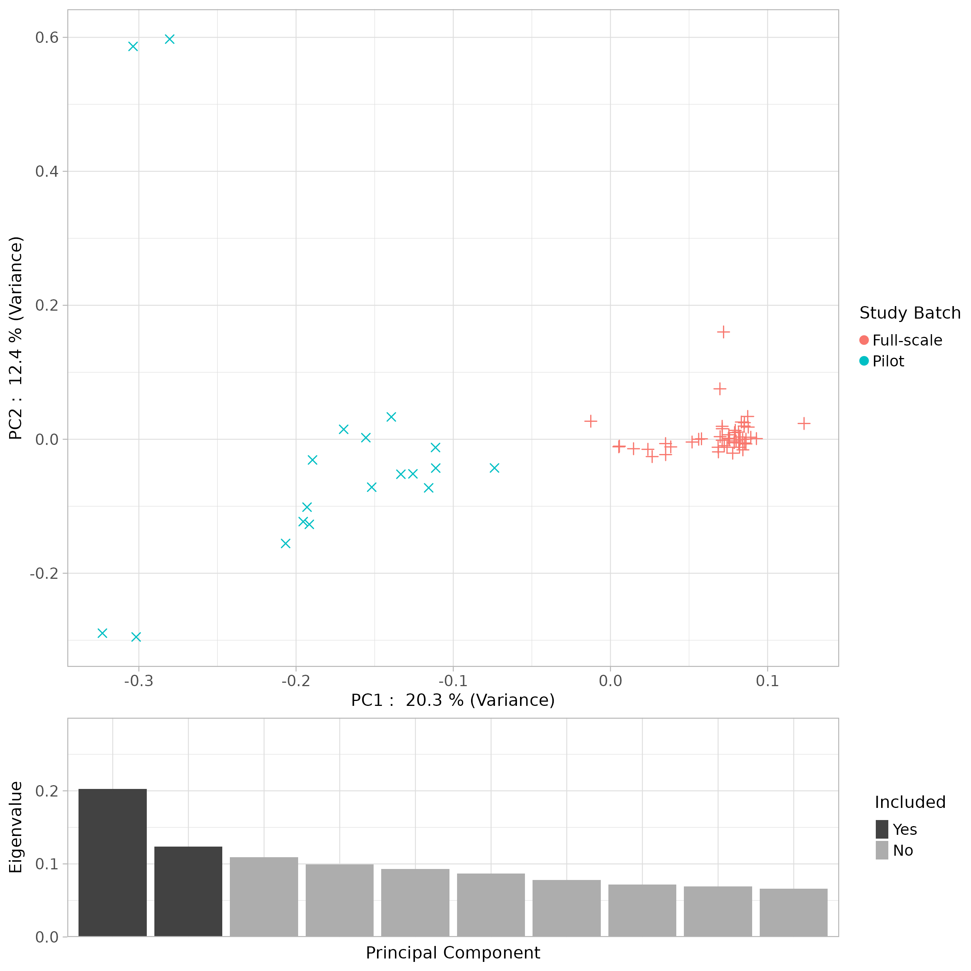
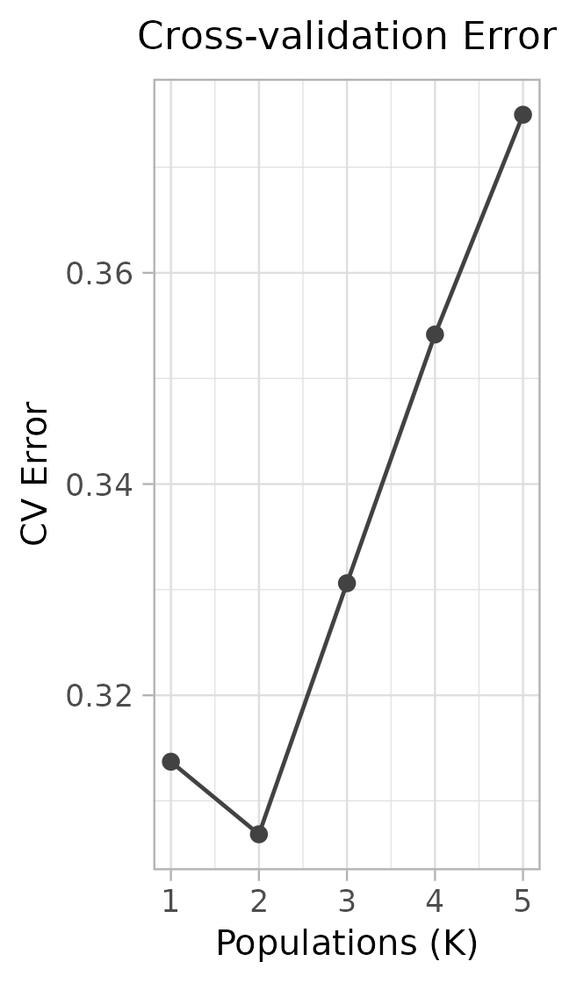
Results: Batch Effects
PCA of 1st and 2nd dimensions
Identifies patterns in genetic relationships between individuals
Reduces the dimensionality of complex genetic data
Clusters correspond to study batch membership

Slide 13
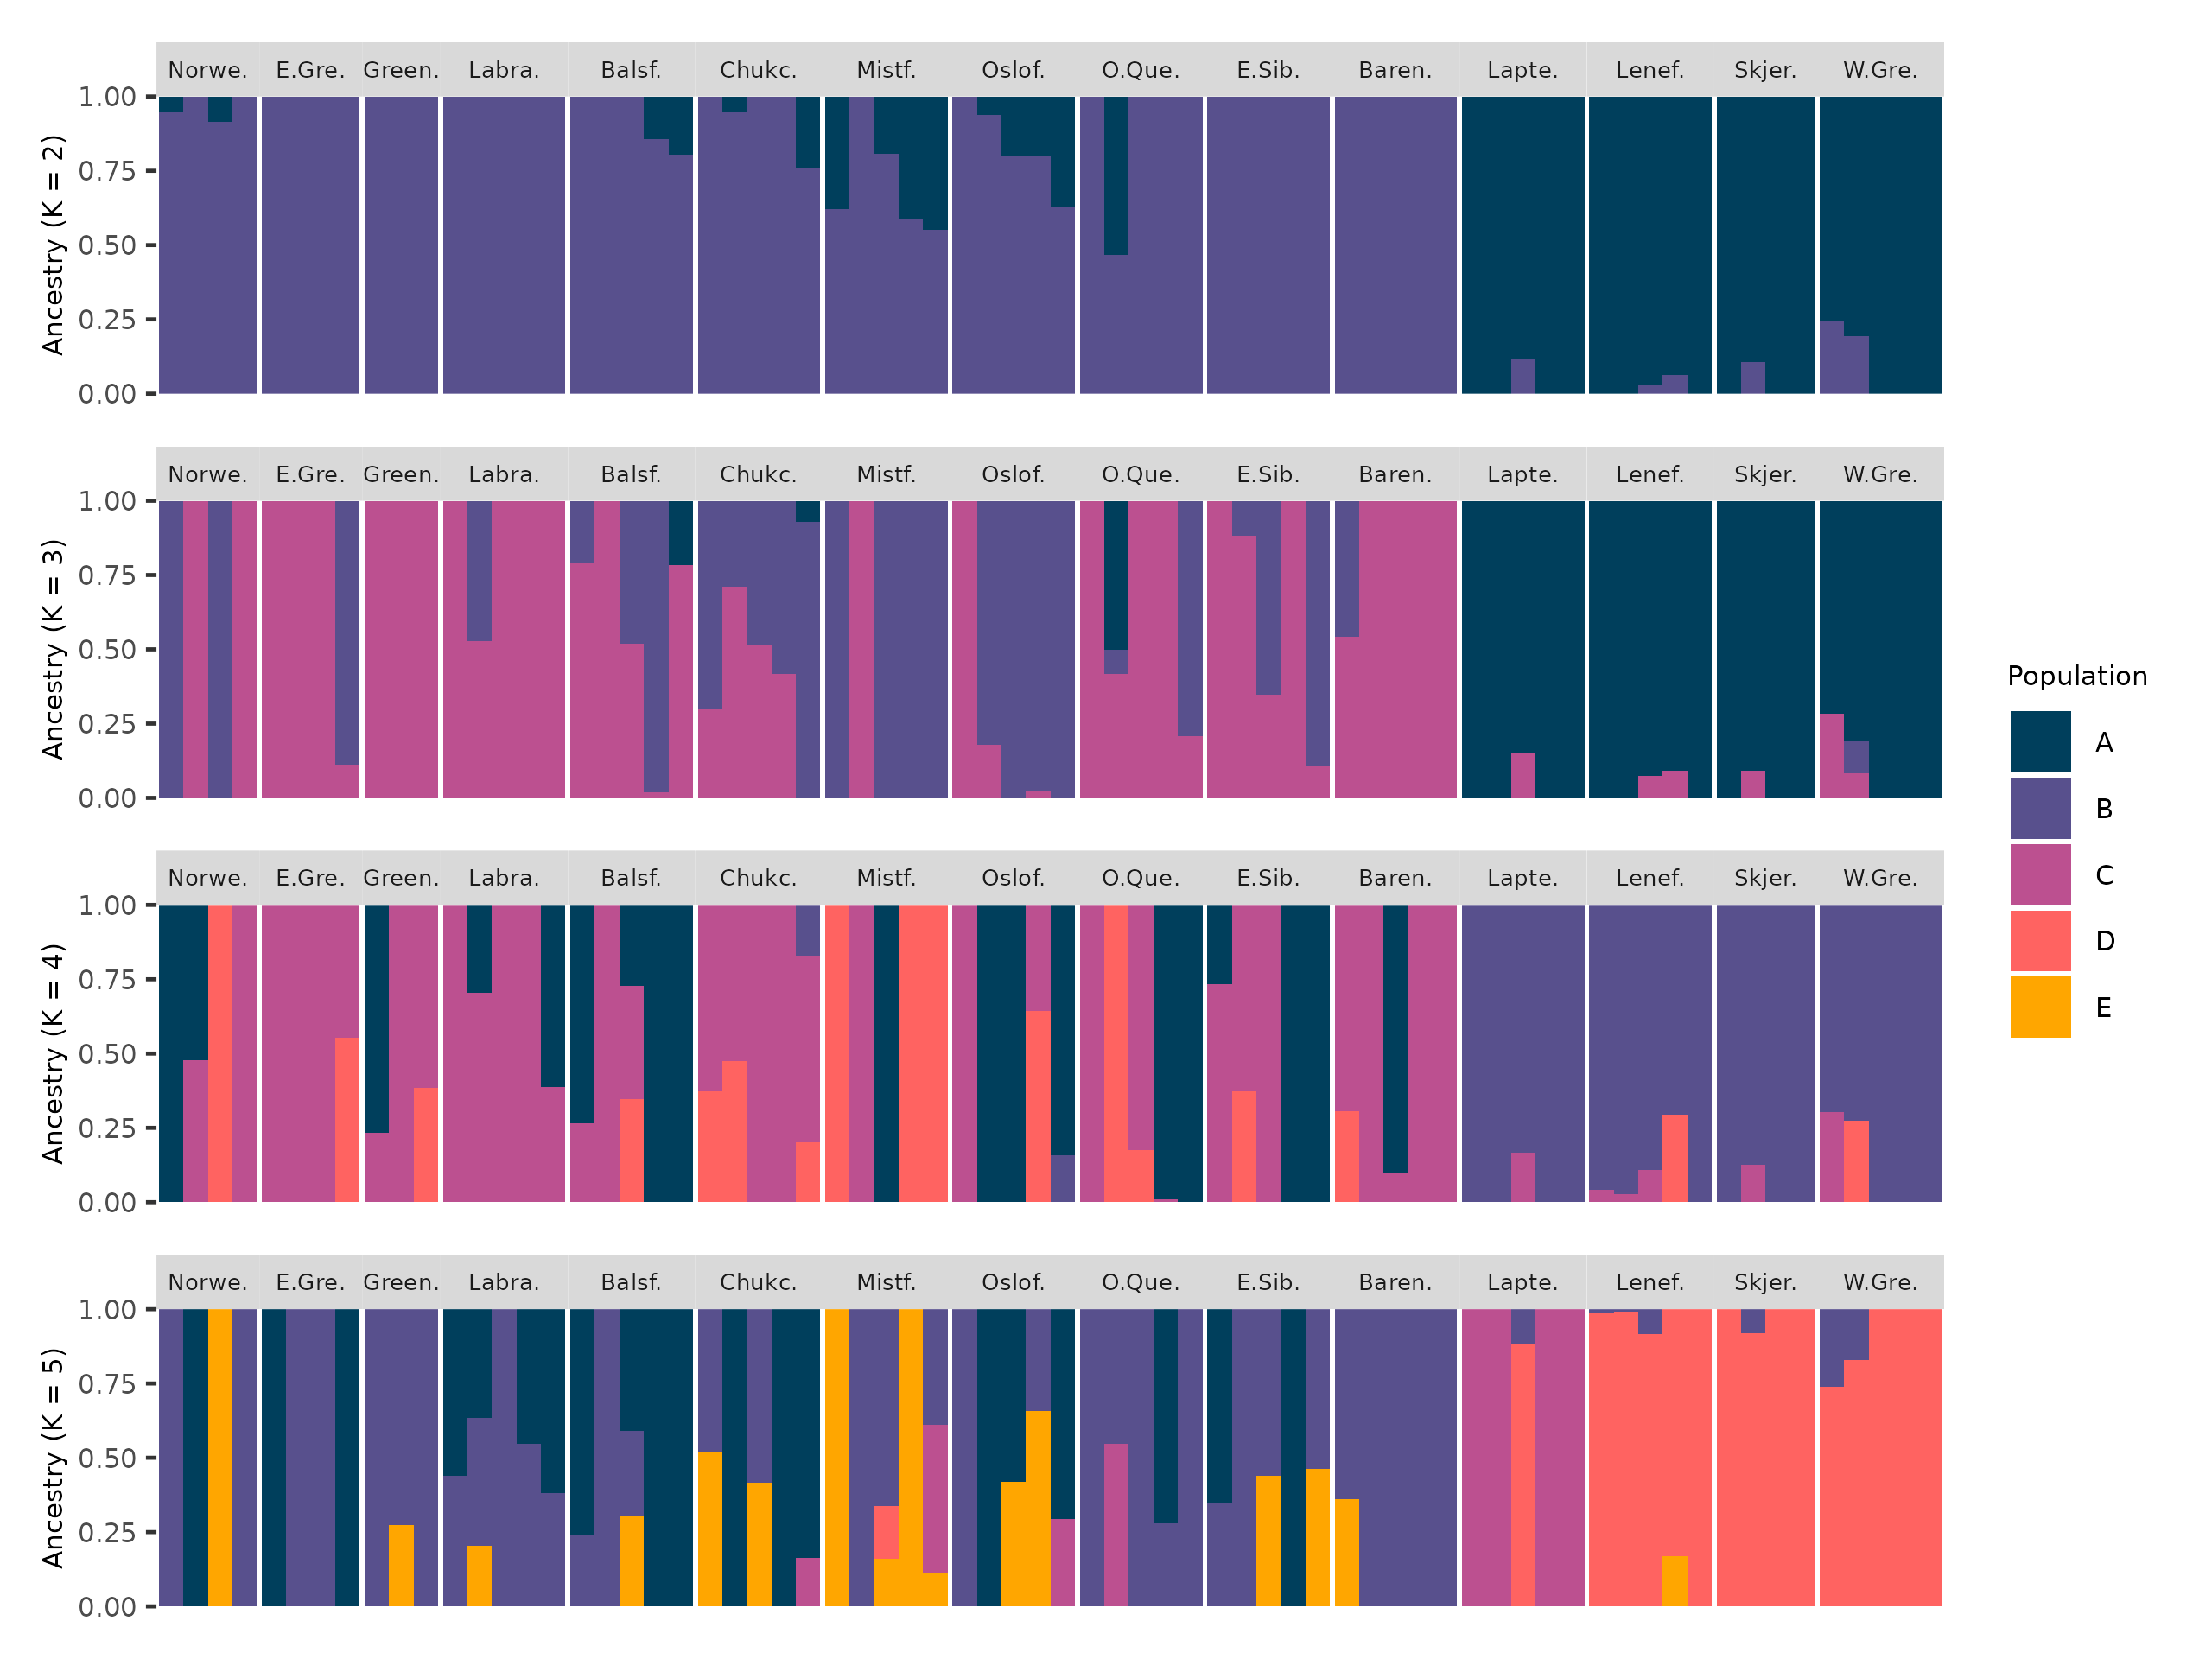
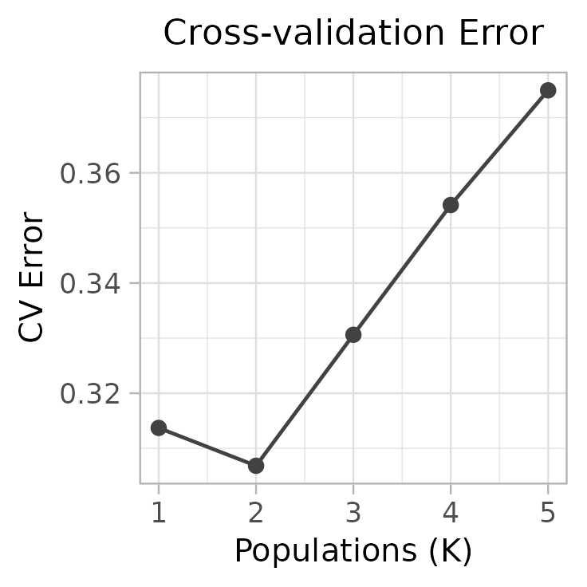
Results: Batch Effects
Admixture
Investigates ancestry of individuals
Potential gene flow between populations
Best fit: Two groups

Slide 14
Mitigating Batch Effects
Presence of batch effects
Mitigation strategy
Focus on full-scale data set
Notes:
Due to these significant batch effects, I decided to focus on the full-scale
dataset for further analysis. This was a strategic choice based on two main reasons:
• Broader geographic representation: The full-scale dataset included samples
from 11 locations compared to 4 in the pilot study, providing a more
comprehensive view of C. hyperboreus.
• Minimizing bias: By excluding the pilot study data, I aimed to minimize the
impact of batch effects and ensure the reliability of downstream analyses.
[Acknowledge the trade-offs: important to acknowledge that this decision resulted in a reduced sample size,
which could potentially limit the statistical power of some analyses. However, I believe
this trade-off was necessary to ensure the robustness and accuracy of the results.

Slide 15
Results:
Population Structure

Slide 16
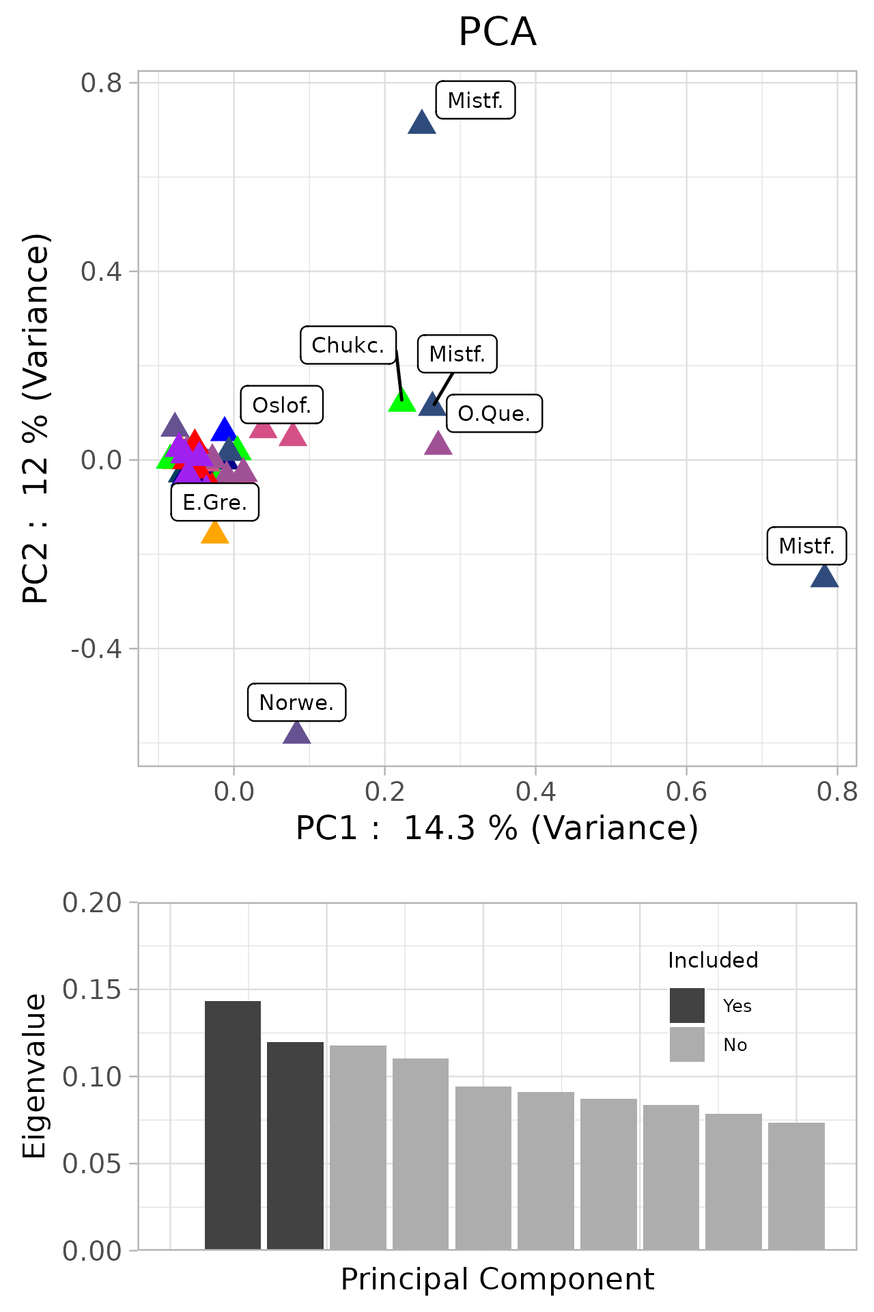
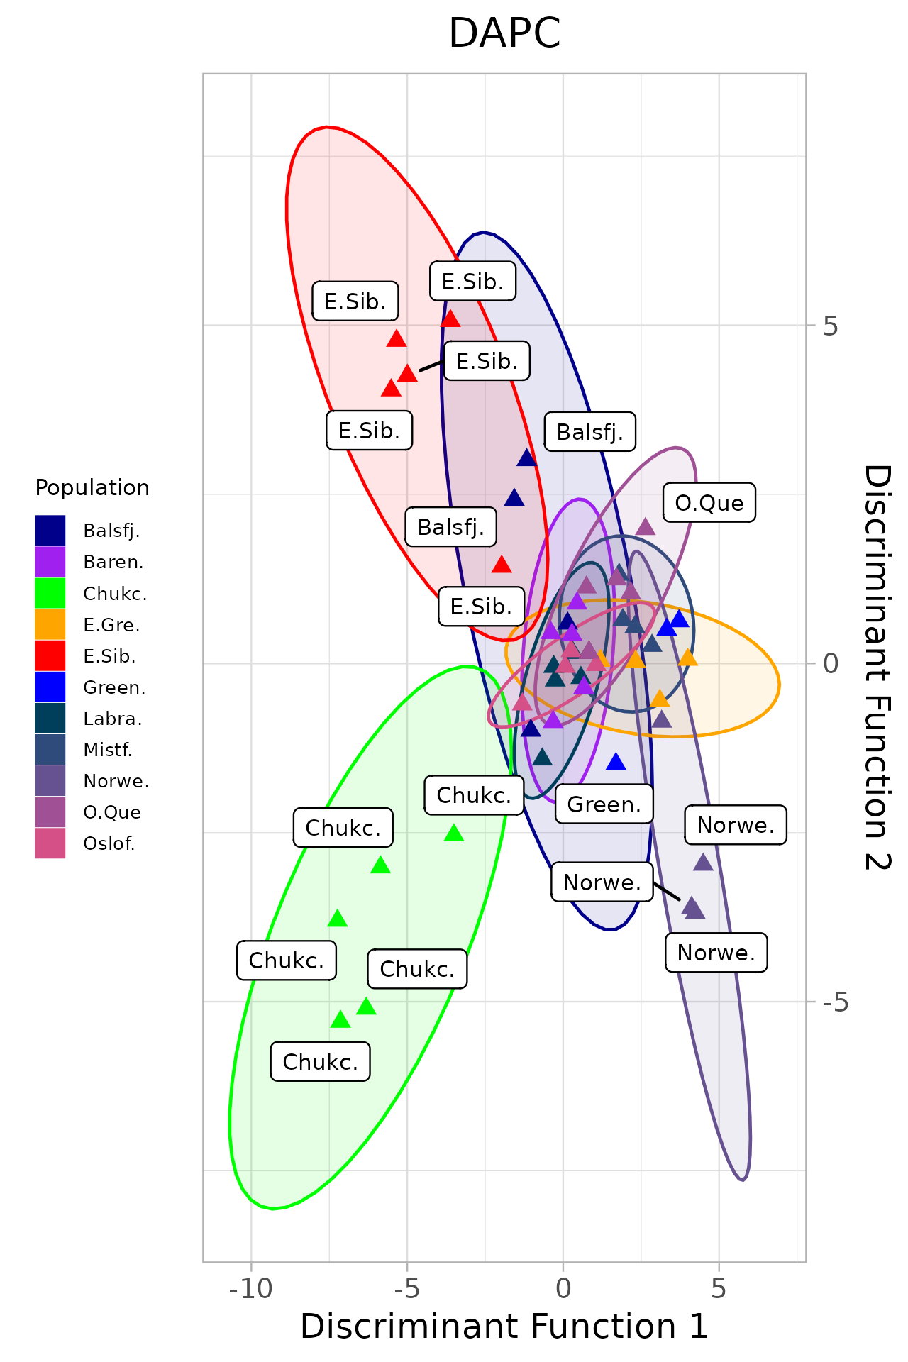
Results: Population Structure
DAPC using sampling locations as the prior
Maximizes between-group separation
Minimizes within-group variance
Distinguishes genetic clusters
PCA: No clear clustering by
location
DAPC: Some clustering by location
Much overlap between locations
Notes:
No CLEAR clustering

Slide 17
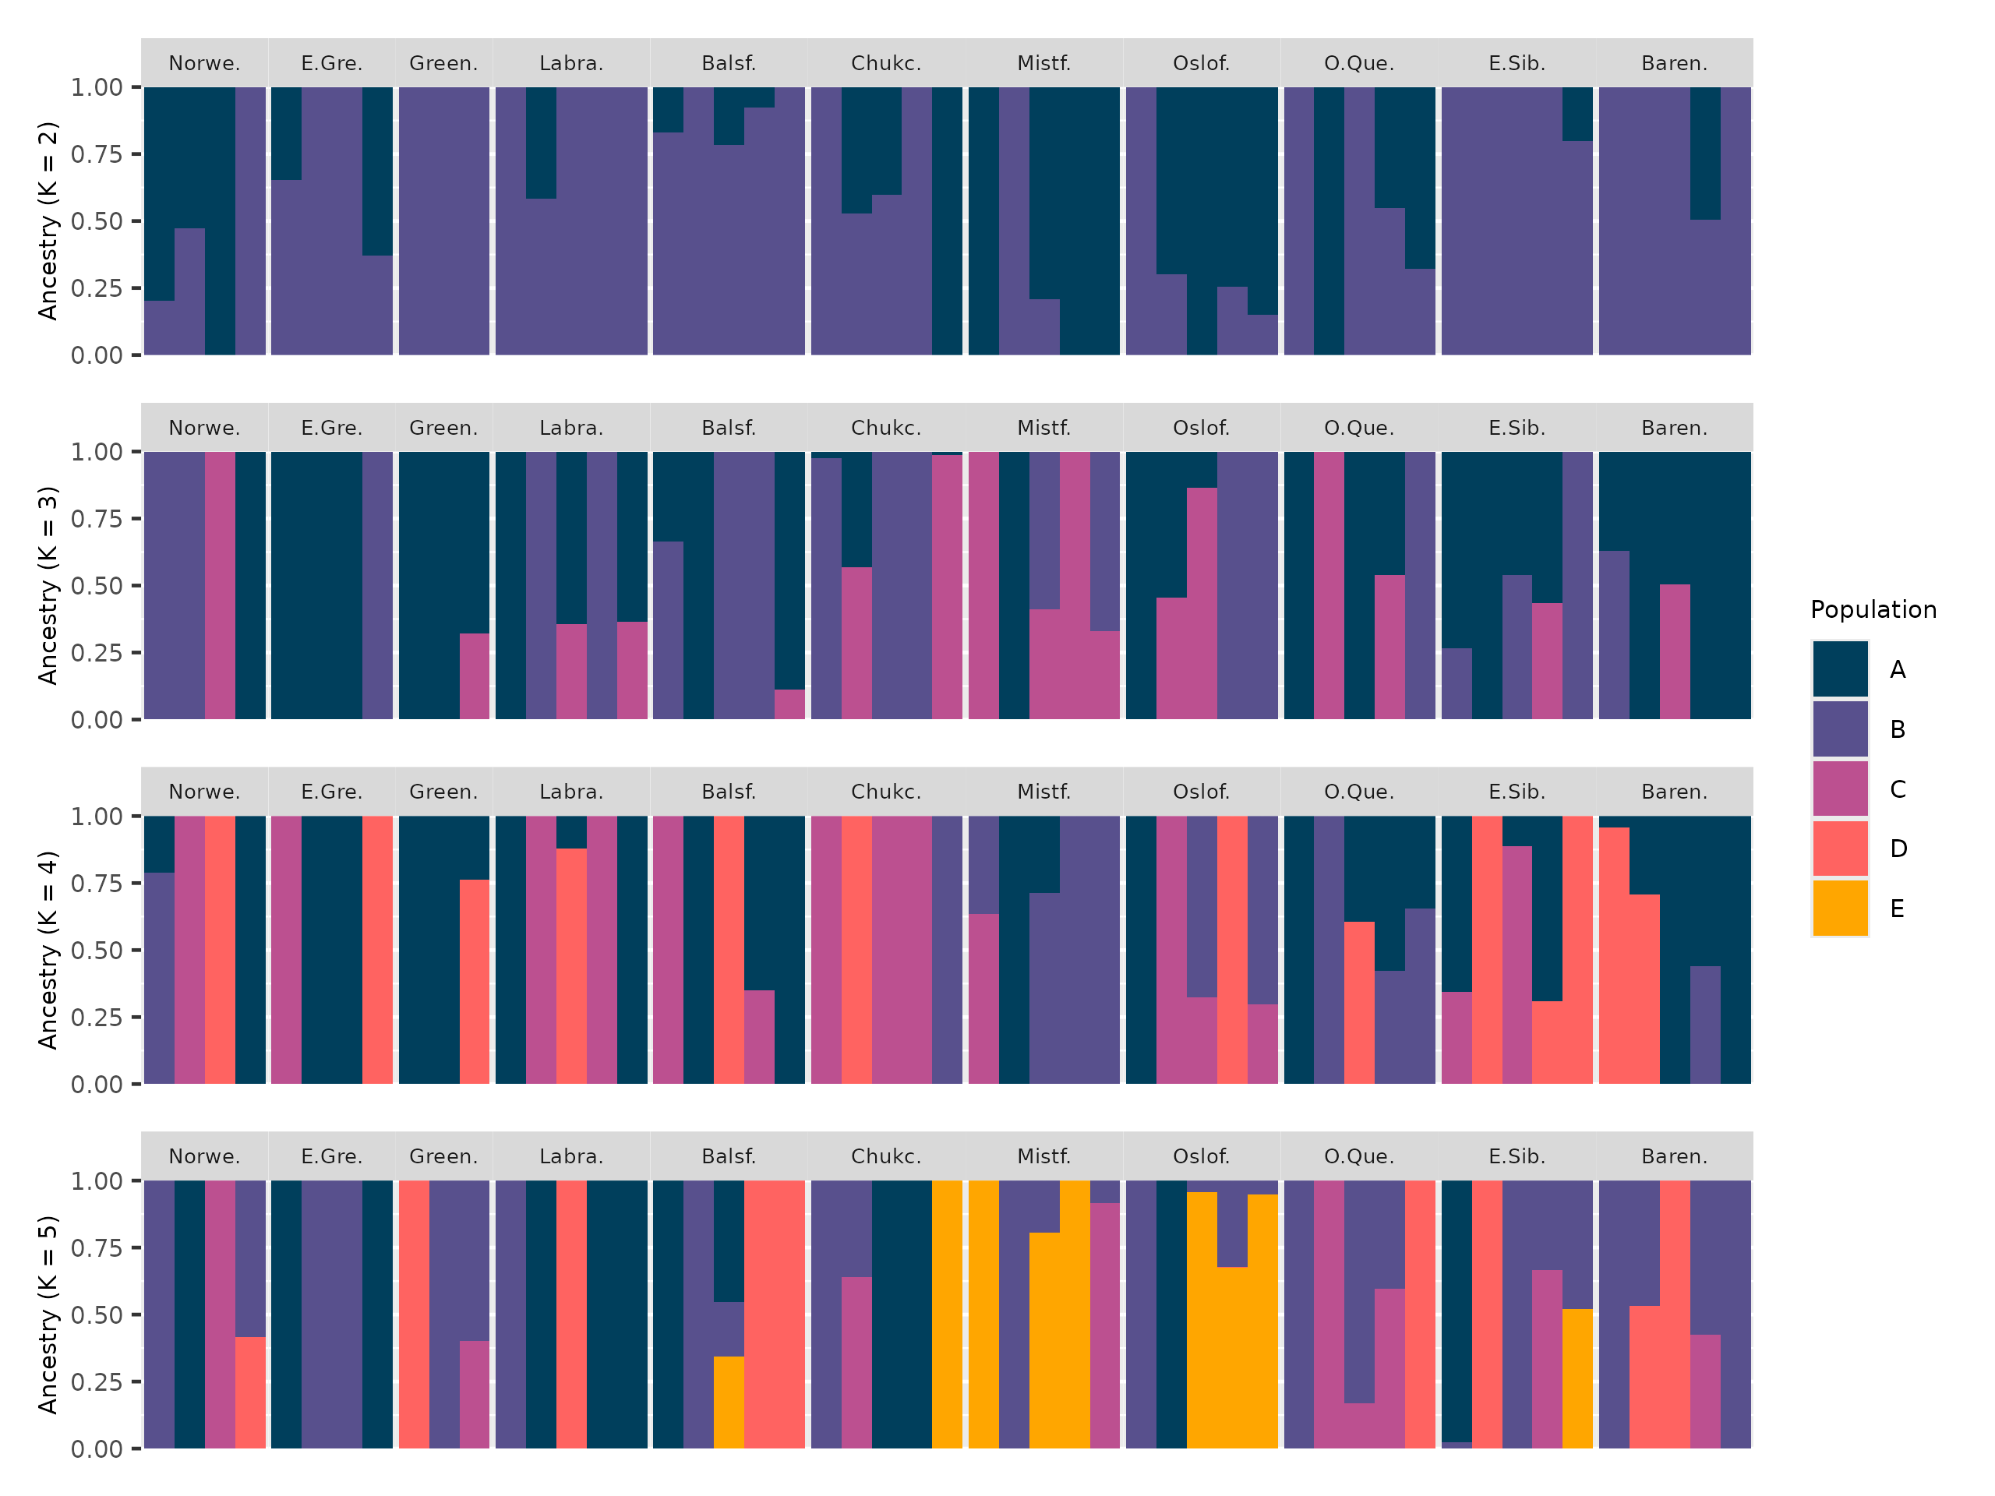
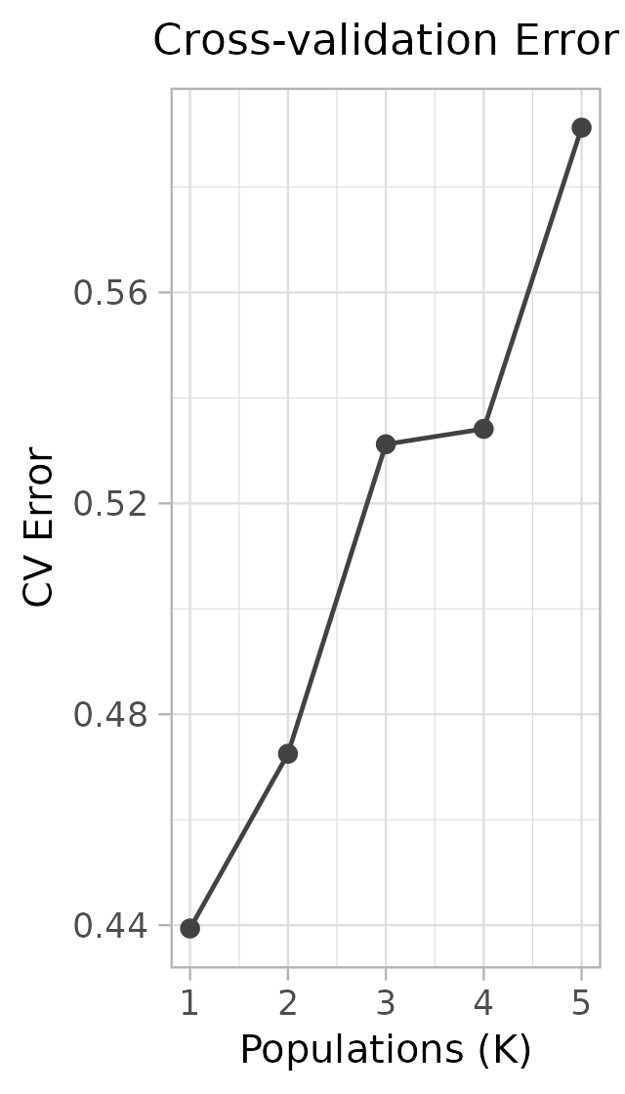
Results: Population Structure
Admixture
Cross-validation
Best fit: One group

Slide 18
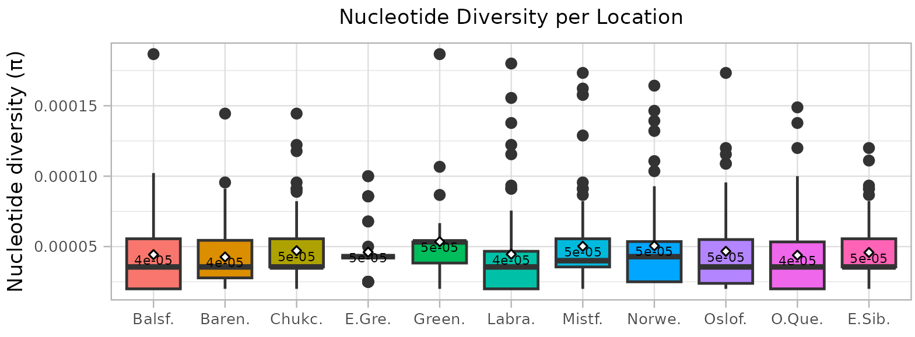
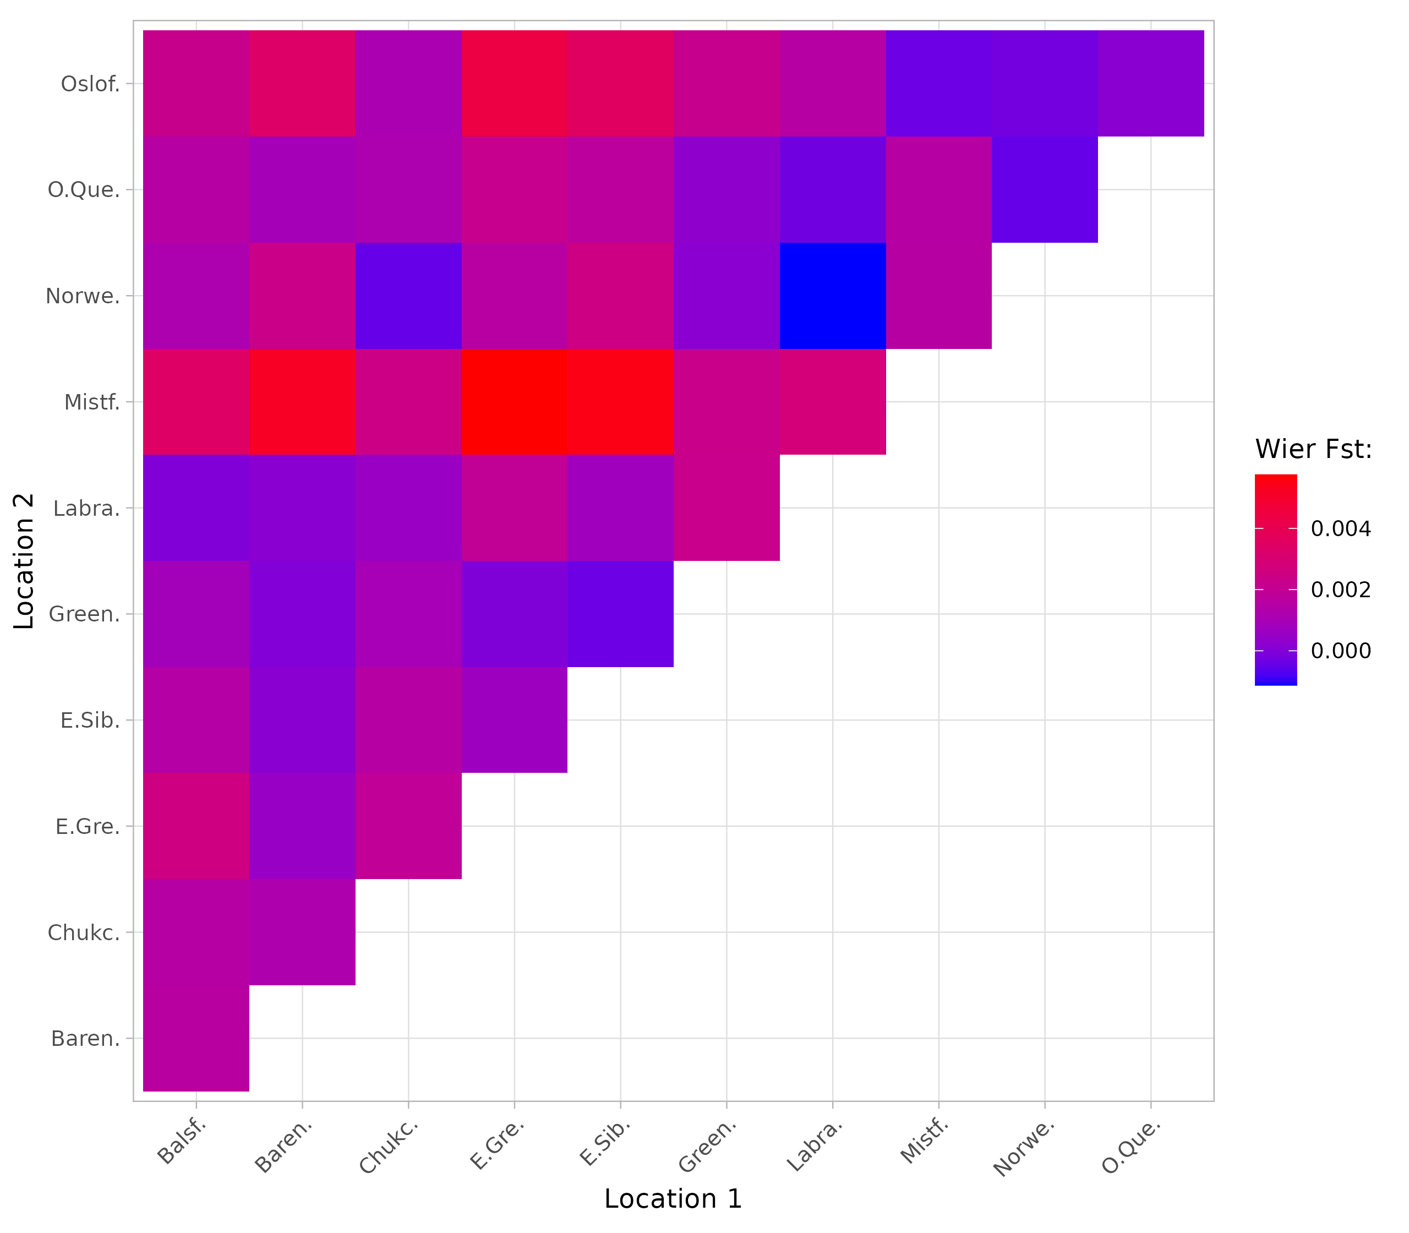
Results: Population Structure
* | * | * | * | * | * | .
 | * | * | * | * |  |  | *
 | * |  | * | * |  |  | *
* | * | * | * | * | *
 |  |  | * |  | *
 |  | * | *
* |  | *
 | *
.
Mean nucleotide diversity (π) per location
Measures genetic diversity with-in populations
Higher values indicate greater diversity
Pairwise Weir-Cockerham F_{ST} comparisons
Quantifies genetic differentiation between pairs of populations
Bonferroni corrected p-values estimated by permutation testing (n = 2000)
Bonferroni adjusted p-value < 0.05 (*)
Mislabelled in the thesis graph (.)

Slide 19
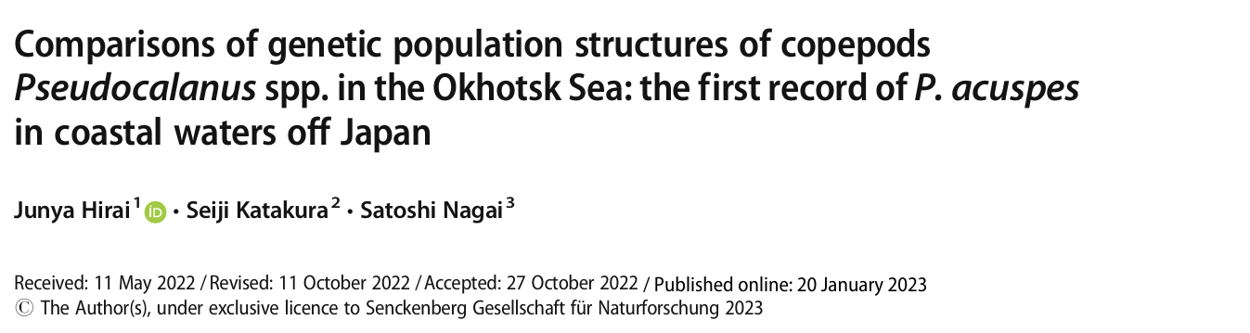
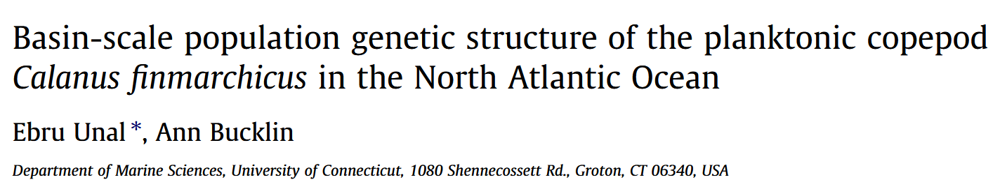
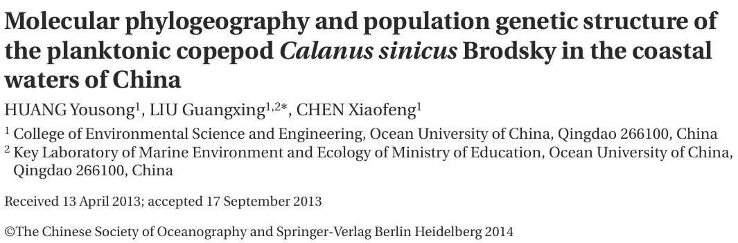
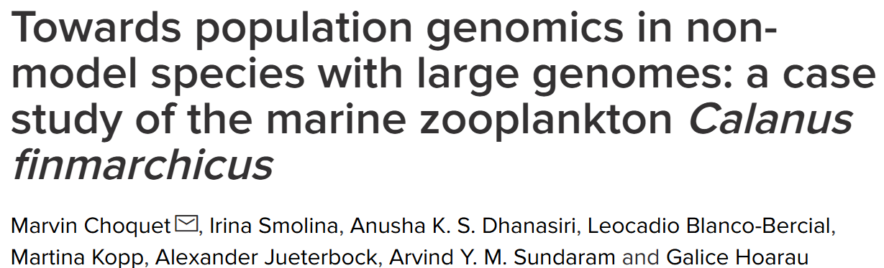
Discussion: Structure
No strong population structure
High gene flow
Subtle differentiation
Other Copepods
Pseudocalanus
P. minutus
P. acuspes
P. newmani
Calanus
C. finmarchicus
C. glacialis
Main Author | Huang (2014) | Unal & Bucklin (2010) | Choquet (2019) | Choquet (2019) | Present study
Species | C. sinicus | C. finmarchicus | C. finmarchicus | C. glacialis | C. hyperboreus | Error (±)
Mean Pair-Fst | 6.00E-02 | 4.84E-02 | NA | NA | 1.48E-03 | 2.83E-04
Nucleotide div. (π) | 2.69E-03 | NA | 6.83E-03 | 7.70E-03 | 4.70E-05 | 2.12E-06
Notes:
Take figures / article titles and include here

Slide 20
Results: Demographic History

Slide 21
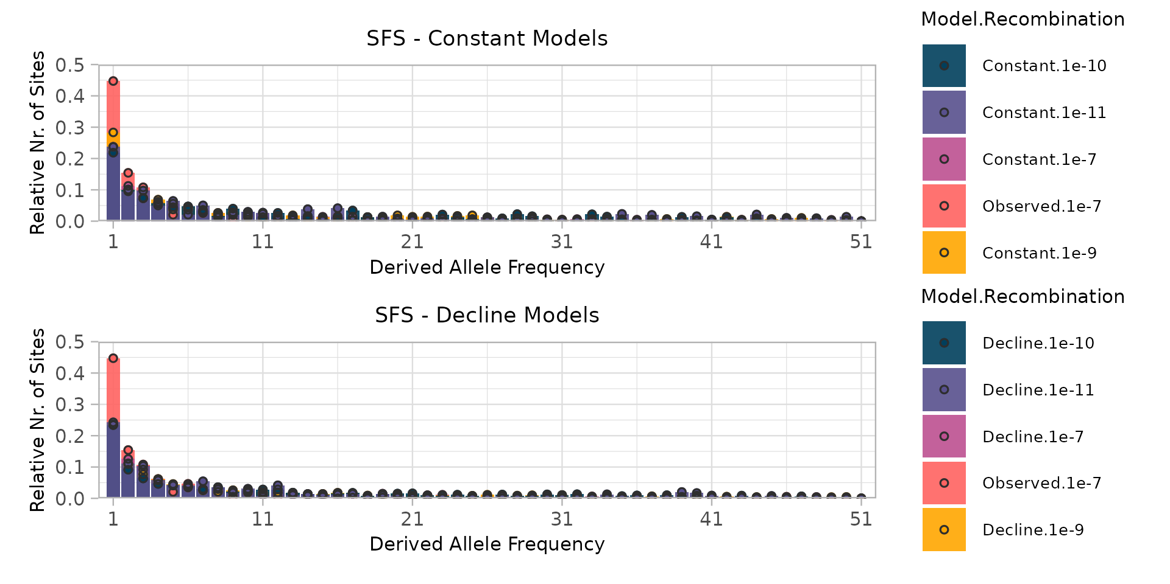
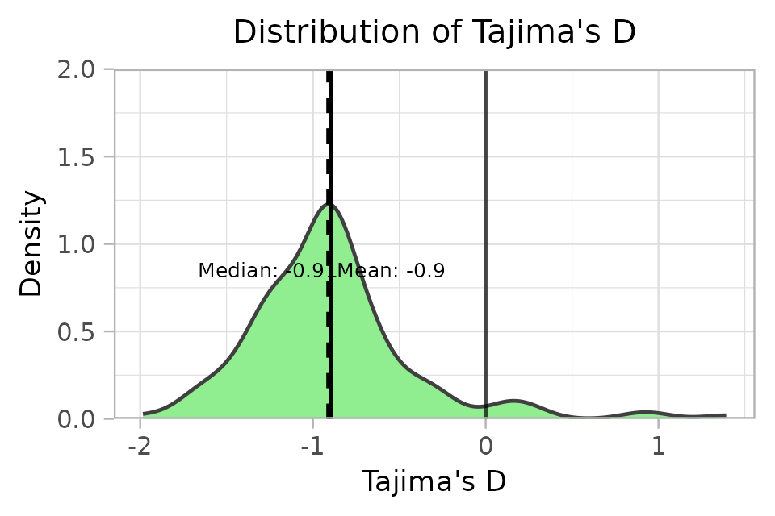
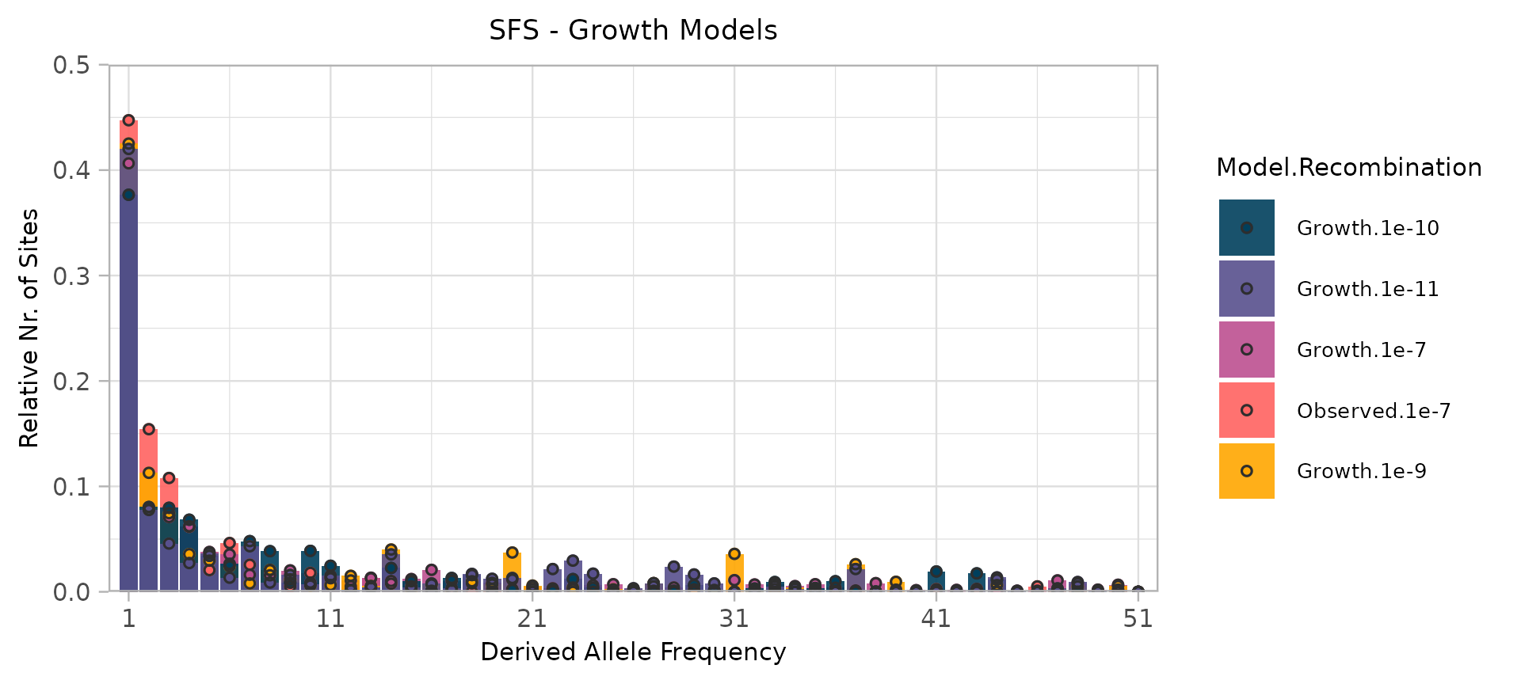
Results: Demographic History
Tajima’s D
Quantifies deviations from neutral evolution
Positive values -> balancing selection or population contraction
Negative values -> purifying selection or population expansion
Site frequency spectrums
Summarizes the distribution of allele frequencies within a population.
Insights into past demographic events and selective pressures
Growth model best fit
Recombination rate 1e-9

Slide 22
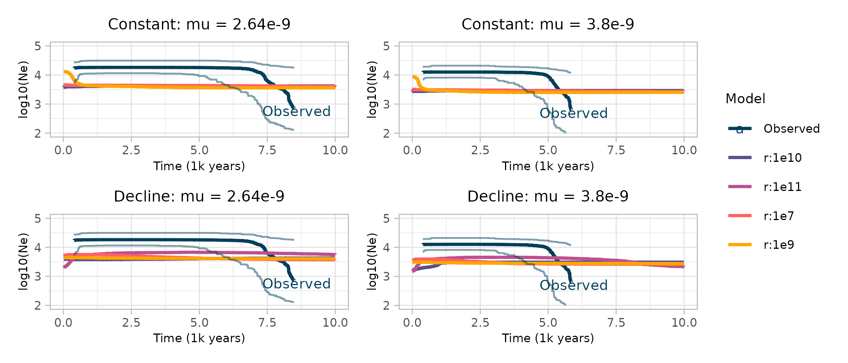
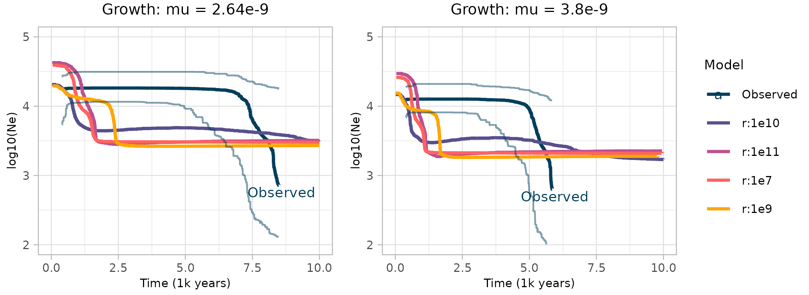
Results: Demographic History
Stairway plots
Visualize changes in effective population size (Ne) over time
Reconstruct demographic history, such as bottlenecks or expansions
Growth model best fit
Mutation rates:
3.8 x 10-⁹ (Daphnia)
2.64 x 10-⁹ (Alpheus)
Best fit: Growth model

Slide 23
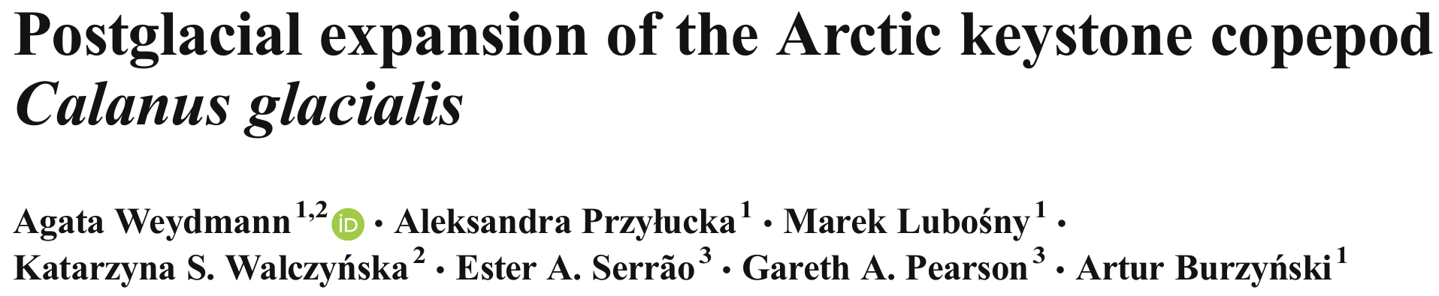
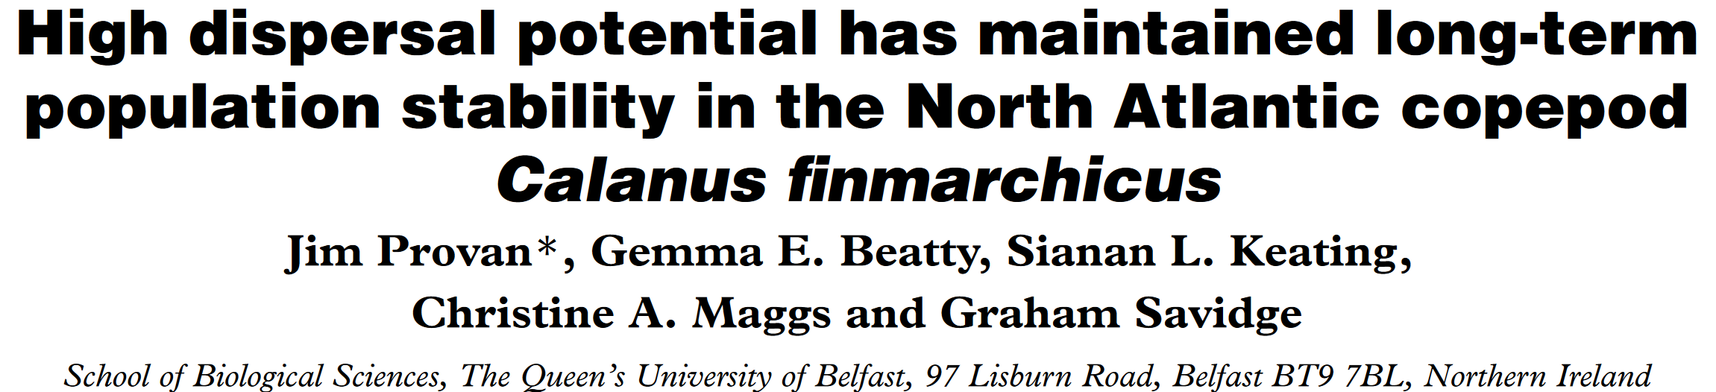
Discussion: Demographic History
Recent population expansion
Low-frequency variants
Possible scenarios:
Recent population expansion
Population bottleneck followed by recovery
Positive selection on rare variants (less likely)
Other Calanus
Stable population sizes in C. finmarchicus
Post-glacial population expansion in C. glacialis
Notes:
Add screenshots/figures from articles

Slide 24
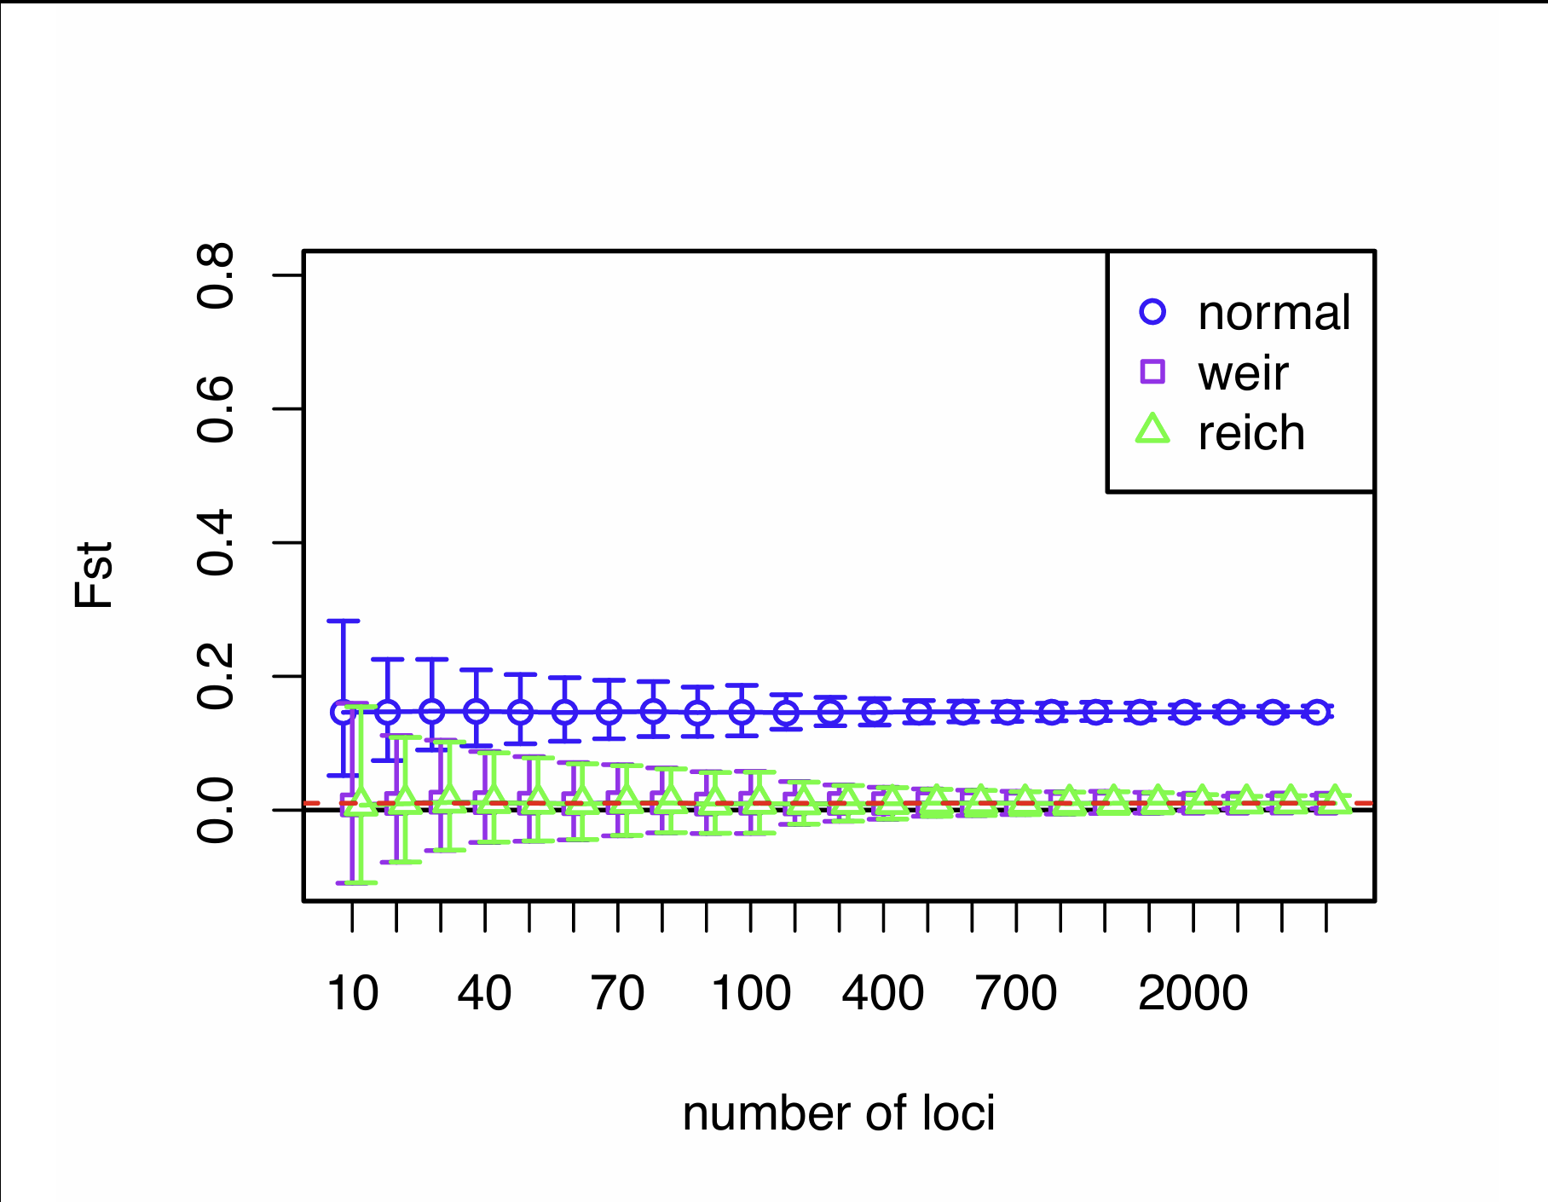
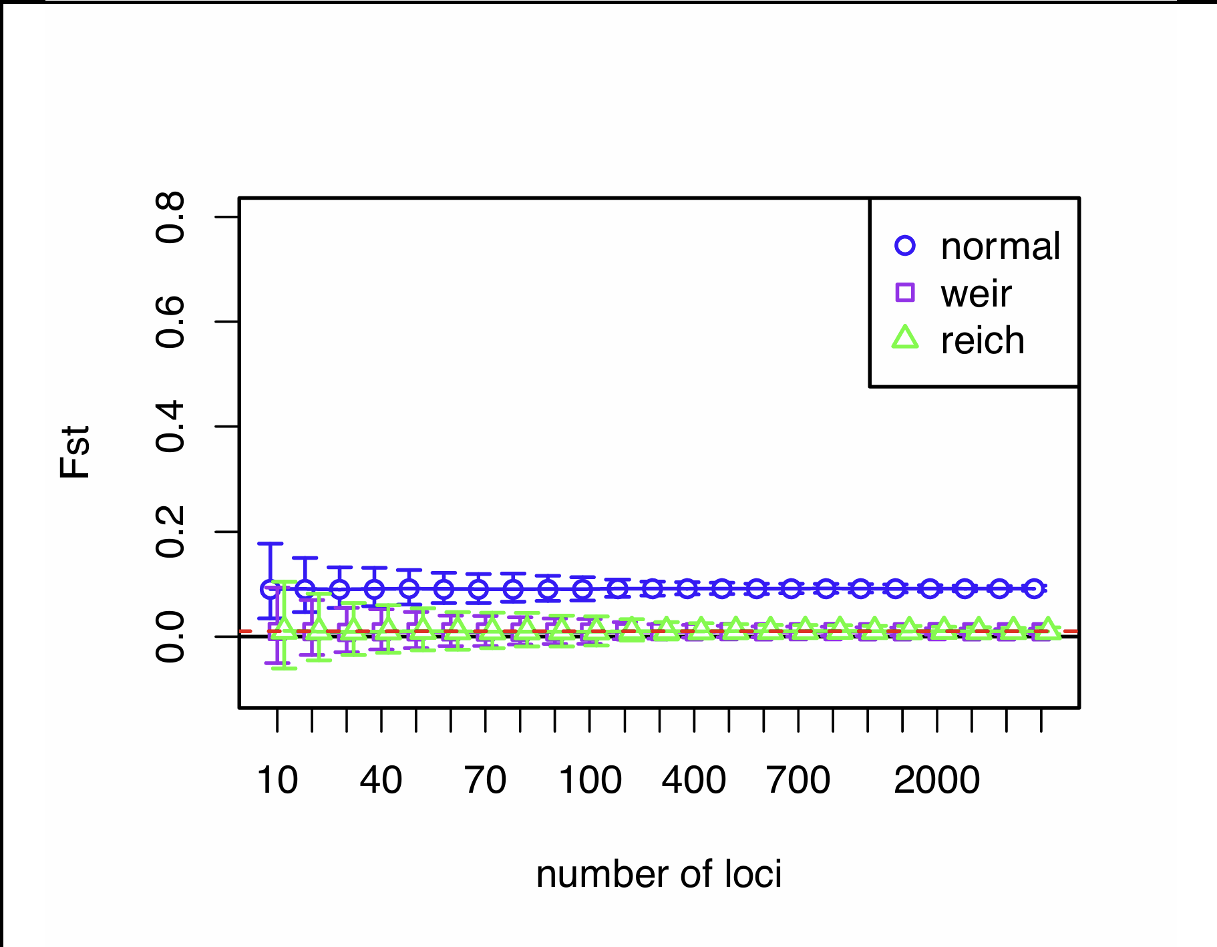
Discussion: Limitations
TCS Probe efficiency
Designed for C. finmarchicus
Low capture rates
Reduced sequencing depth
Fewer genomic regions represented
Limited Sample Sizes
Low number of samples per location
Low number of SNPs
Lack of Mutation and Recombination rates
Recent population expansion
Precise timing and magnitude
Sample nr (n) = 4
Sample nr (n) = 20
(Willing, Dreyer and Oosterhout, 2012)

Slide 25
Conclusion: Implications for Conservation and Management
Genetic Diversity & Connectivity
High gene flow -> Resilience to environmental change
Subtle differentiation -> Potential for local adaptation
Ecological Significance
Keystone species: Critical for Arctic food web stability
Management Recommendations
Prioritize regional conservation
Acknowledging genetic & adaptive differences
Future Research
Expand sampling: Understand population dynamics
Develop efficient capture methods for C. hyperboreus
Investigate demographic history & local adaptations

